Slide 1

Many ways to track changes in SQL Server
John Miner Data Architect
john.miner@insight.com

Slide 2
Agenda
01 | Overview
02 | Table Triggers
03 | SQL Audit
04 | Change Data Capture
05 | Change Table Tracking
06 | Change Stream

Slide 3
Overview
Some industries are more regulated and have stricter compliance regulations than others.
The business requirement to provide an audit trail to a compliance officer when a security issue arises is “table stakes” in most organizations.
For large data sets, capturing changes for an incremental load eliminates the need for a full load every day.
Today, we are going to review the many ways to audit and capture changes.

Slide 4
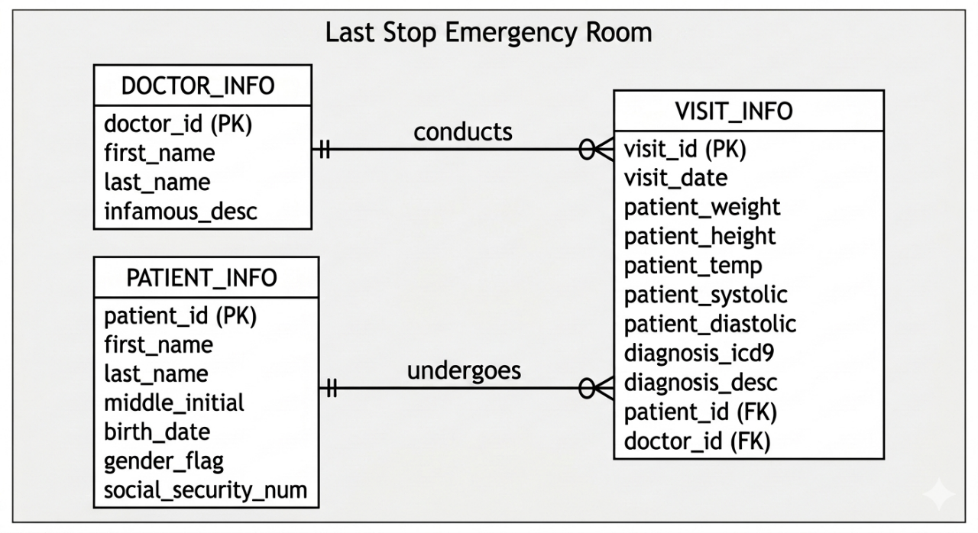
Emergency Room (HIPPA) Schema
We have taken the worst doctors in the world and placed them into this ER department.
Patients come to see the doctors. Hopefully, this is not their last stop in life!

Slide 5
Table Triggers
Technology
Triggers can be defined at both the server and database levels. These triggers can capture changes as an XML record set that can be stored for future use.
Benefits
The XML format allows for schema drift. The reversal of insert, update, or delete actions can be achieve by finding these records in a table.
Drawbacks
We can not determine if any end users selected data from a given table. This is important for HIPPA regulations. *

Slide 6
SQL Server Audit
Technology
Built into SQL Server is the ability to create an AUDIT – where to store files and a SPECIFICATION – which actions to monitor.
Benefits
The audit log can be viewed using a system stored procedure. All actions can be monitored.
Drawbacks
The data from of the insert, update, and delete actions is not captured. Therefore, we can not roll back changes.

Slide 7
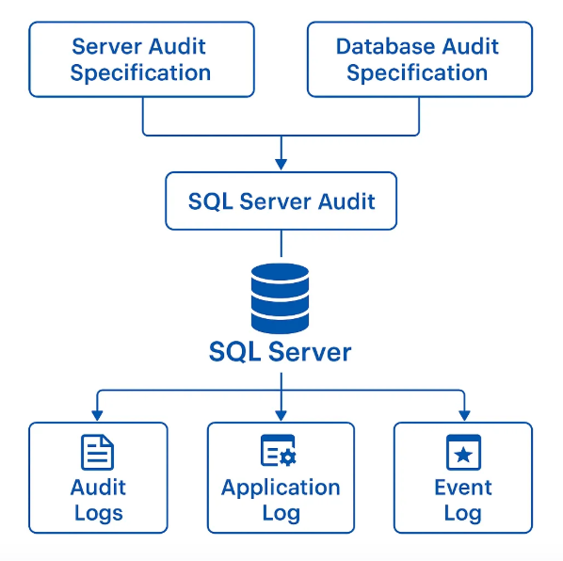
Architecture Diagram – SQL Server Audit
There are many target locations for a SQL Server Audit.
Please check the documentation for your database version (on-premises or in-cloud).
This feature was introduced in 2008.

Slide 8
Change Data Capture
Technology
Enable tracking at both the database and table level.
Benefits
Does capture changes in system tables.
Drawbacks
Does not handle schema drift. Unable to track viewers.

Slide 9
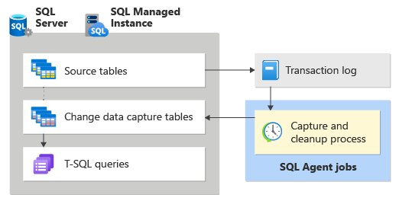
Architecture Diagram – CDC
SQL Agent must be active for this technology to work.
Since it is a scheduled job, the flow of data from source to CDC tables may take some time.
This feature has been available since version 2008.

Slide 10
Change (Table) Tracking
Technology
Enable tracking at both the database and table level.
Benefits
Does capture changes in system tables. Various stored procedures can be used to return the data.
Drawbacks
We must specify the number of days to store changes. Any table data before enabling must be captured from the base table. Unable to determine who viewed the data.

Slide 11
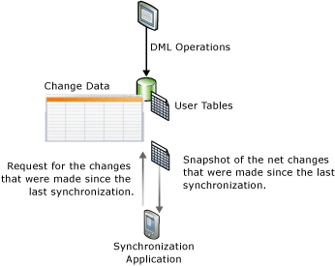
Architecture Diagram – Change Tracking
Version numbers are used to keep track of the changes in a system table.
Using stored procedures, we can retrieve the data as well as the change action (insert, update, or delete).
This feature came out in 2019.

Slide 12
Change Event Stream
Technology
Enable tracking at both the database and table level.
Benefits
Capture data is sent to an event hub as a JSON document.
Drawbacks
Just like all change tracking technologies, we are unable to determine who viewed the data.

Slide 13
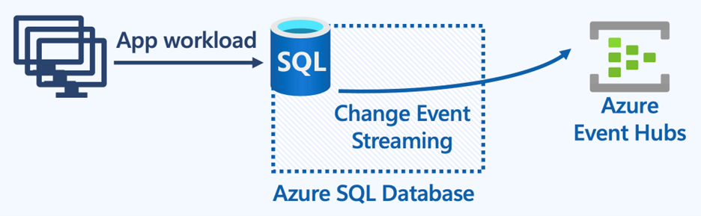
Architecture Diagram – Change Event Stream
Must define an Event Hub to capture the data.
Must enable the preview feature in SQL Server 2025.

Slide 14
Summary
There are many ways to track changes in SQL Server. Personally, I like using Table Triggers and SQL Audit to get a whole picture of what is going on in a particular database.
If I am using the technology for incremental loads, then Change Tracking is my method of choice.
The most recent product enhancement is Change Stream. This was introduced so that schema drift could happen with Fabric Database Mirroring.
In summary, pick the technology that best fits your business problem.

Slide 15
References
Table Triggers
https://tinyurl.com/49tn4j6c
SQL Server Audit
https://tinyurl.com/249rp7xy
Change Data Capture
https://tinyurl.com/yck8n9hs
Change (Table) Tracking
https://tinyurl.com/wvntzvkw
Change Event Stream
https://tinyurl.com/4dz7yanu

